Slide 1
ACADEMIC YEAR -2023-24( ODD SEM)
Subject: RESEARCH METHODOLOGY & INTELLECTUAL PROPERTY RIGHTS Subject Code: 21RMI56
Prepared By,
Dr Hussana Johar R B
Assistant Professor
Dept of AI&ML
ATMECE,Mysore

Slide 2
MODULE-1 5 Hr
Introduction: Meaning of Research, Objectives of Engineering Research, and Motivation in Engineering Research, Types of Engineering Research, Finding and Solving a Worthwhile Problem. Ethics in Engineering Research, Ethics in Engineering Research Practice, Types of Research Misconduct, Ethical Issues Related to Authorship.
MODULE-2 5 Hr
Literature Review and Technical Reading, New and Existing Knowledge, Analysis and Synthesis of Prior Art Bibliographic Databases, Web of Science, Google and Google Scholar, Effective Search: The Way Forward Introduction to Technical Reading Conceptualizing Research, Critical and Creative Reading, Taking Notes While Reading, Reading Mathematics and Algorithms, Reading a Datasheet. Attributions and Citations: Giving Credit Wherever Due, Citations: Functions and Attributes, Impact of Title and Keywords on Citations, Knowledge Flow through Citation, Citing Datasets, Styles for Citations, Acknowledgments and Attributions, What Should Be Acknowledged, Acknowledgments in, Books Dissertations, Dedication or Acknowledgments..

Slide 3
MODULE-3 5 Hr
Introduction To Intellectual Property: Role of IP in the Economic and Cultural Development of the Society, IP Governance, IP as a Global Indicator of Innovation, Origin of IP History of IP in India. Major Amendments in IP Laws and Acts in India.
Patents: Conditions for Obtaining a Patent Protection, To Patent or Not to Patent an Invention. Rights Associated with Patents. Enforcement of Patent Rights. Inventions Eligible for Patenting. Non-Patentable Matters. Patent Infringements. Avoid Public Disclosure of an Invention before Patenting. Process of Patenting. Prior Art Search. Choice of Application to be Filed. Patent Application Forms. Jurisdiction of Filing Patent Application. Publication. Pre-grant Opposition. Examination. Grant of a Patent. Validity of Patent Protection. Post-grant Opposition. Commercialization of a Patent. Need for a Patent Attorney/Agent. Can a Worldwide Patent be Obtained. Do I Need First to File a Patent in India. Patent Related Forms. Fee Structure. Types of Patent Applications. Commonly Used Terms in Patenting. National Bodies Dealing with Patent Affairs. Utility Models.
Process of Patenting: Prior Art Search. Choice of Application to be Filed. Patent Application Forms. Jurisdiction of Filing Patent Application. Publication. Pre-grant Opposition. Examination. Grant of a Patent. Validity of Patent Protection. Post-grant Opposition. Commercialization of a Patent. Need for a Patent Attorney/Agent. Can a Worldwide Patent be Obtained. Do I Need First to File a Patent in India. Patent Related Forms. Fee Structure. Types of Patent Applications. Commonly Used Terms in Patenting. National Bodies Dealing with Patent Affairs. Utility Models.

Slide 4
MODULE-4 5 Hr
Copyrights and Related Rights: Classes of Copyrights. Criteria for Copyright. Ownership of Copyright. Copyrights of the Author. Copyright Infringements. Copyright Infringement is a Criminal Offence. Copyright Infringement is a Cognizable Offence. Fair Use Doctrine. Copyrights and Internet. Non-Copyright Work. Copyright Registration. Judicial Powers of the Registrar of Copyrights. Fee Structure. Copyright Symbol. Validity of Copyright. Copyright Profile of India. Copyright and the word ‘Publish’. Transfer of Copyrights to a Publisher. Copyrights and the Word ‘Adaptation’. Copyrights and the Word ‘Indian Work’. Joint Authorship. Copyright Society. Copyright Board. Copyright Enforcement Advisory Council (CEAC). International Copyright Agreements, Conventions and Treaties. Interesting Copyrights Cases.
Trademarks: Eligibility Criteria. Who Can Apply for a Trademark. Acts and Laws. Designation of Trademark Symbols. Classification of Trademarks. Registration of a Trademark is Not Compulsory. Validity of Trademark. Types of Trademark Registered in India. Trademark Registry. Process for Trademarks Registration. Prior Art Search. Famous Case Law: Coca-Cola Company vs. Bisleri International Pvt. Ltd.

Slide 5
MODULE-5 5 Hr
Industrial Designs: Eligibility Criteria. Acts and Laws to Govern Industrial Designs. Design Rights. Enforcement of Design Rights. Non-Protectable Industrial Designs India. Protection Term. Procedure for Registration of Industrial Designs. Prior Art Search. Application for Registration. Duration of the Registration
of a Design. Importance of Design Registration. Cancellation of the Registered Design. Application Forms.
Classification of Industrial Designs. Designs Registration Trend in India. International Treaties. Famous Case
Law: Apple Inc. vs. Samsung Electronics Co.
Geographical Indications: Acts, Laws and Rules Pertaining to GI. Ownership of GI. Rights Granted to the
Holders. Registered GI in India. Identification of Registered GI. Classes of GI. Non-Registerable GI. Protection
of GI. Collective or Certification Marks. Enforcement of GI Rights. Procedure for GI Registration Documents
Required for GI Registration. GI Ecosystem in India.
Case Studies on Patents. Case study of Curcuma (Turmeric) Patent, Case study of Neem Patent, Case study of Basmati patent. IP Organizations In India. Schemes and Programmes

Slide 6
Course Outcome
The student will be able to:
CO1. To know the meaning of engineering research.
CO2. To know the procedure of Literature Review and Technical Reading
CO3. To know the fundamentals of patent laws and drafting procedure CO4. Understanding the copyright laws and subject matters of copyrights and designs
CO5. Understanding the basic principles of design rights .

Slide 7
Text books:
1. Dipankar Deb • Rajeeb Dey, Valentina E. Balas “Engineering Research Methodology”, ISSN 1868- 4394 ISSN 1868-4408 (electronic), Intelligent Systems Reference Library, ISBN 978-981-13- 2946-3 ISBN 978-981-13-2947-0 (eBook), https://doi.org/10.1007/978-981-13-2947-0
2. Intellectual Property A Primer for Academia by Prof. Rupinder Tewari Ms. Mamta Bhardwa.
Reference Books:
1. David V. Thiel “Research Methods for Engineers” Cambridge University Press, 978-1-107-03488- 4 –
2. Intellectual Property Rights by N.K.Acharya Asia Law House 6th Edition. ISBN: 978-93-81849-30-9.

Slide 8
.
MODULE -1
INTRODUCTION

Slide 9
CONTENTS
PART-1
Meaning of Research
Objectives of Engineering Research
Motivation in Engineering Research
Types of Engineering Research
Finding and Solving a Worthwhile Problem.
PART-2
Ethics in Engineering Research
Ethics in Engineering Research Practice
Types of Research Misconduct
Ethical Issues Related to Authorship.

Slide 10
PART-1
MEANING OF RESEARCH
Research refers to –
A careful, well-defined (or redefined), objective, and systematic method of search for knowledge, or formulation of a theory which is unknown and useful on a particular aspect so as to make an original contribution to expand the existing knowledge.
Research involves-
Formulation of hypothesis
Data analysis
Deduction
Ascertaining whether the conclusions fit the hypothesis.
Research is a process of creating, or formulating knowledge that does not yet exist.

Slide 11
.
The research cycle starts with basically a practical problem:
one must be clear what the problem being attempted to solve is and why it is important.
this problem motivates a research question without which one can tend to get lost in a giant swamp of information.
in turn defines a research project which is an activity or set of activities that ultimately leads to result helps to solve the practical problem that one started with in the first place as shown in Fig. 1.1.

Slide 12
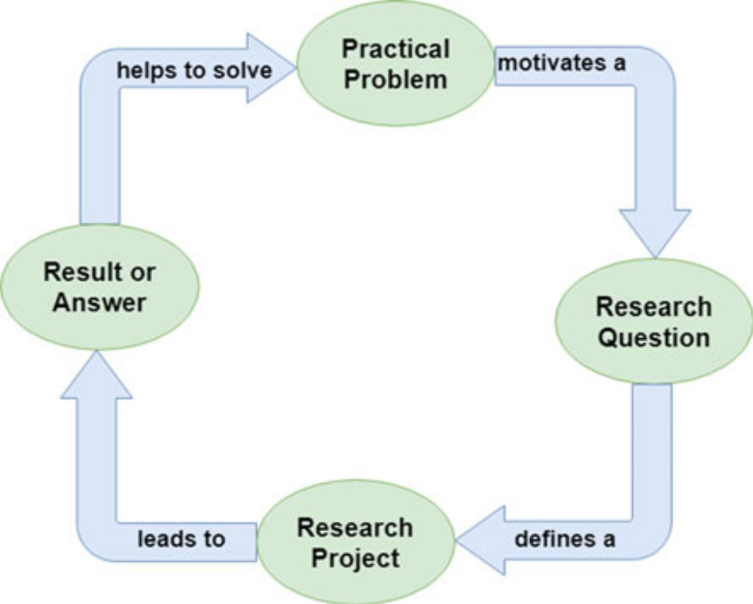
.
Fig. 1.1 The research flow diagram

Slide 13
.
Research is not just about reading a lot of books and finding a lot of, gathering a lot of existing information. It is instead contributing to that existing body of knowledge.
So, research is about how one poses a question which has relevance to the world that we are living in, and while looking for that answer one has to be as systematic as one can be.
The objective of a good research program is to try and gain insight into something. Or indeed, to try and solve a problem.
Good research questions develop throughout the project actually and one can even keep modifying them.

Slide 14
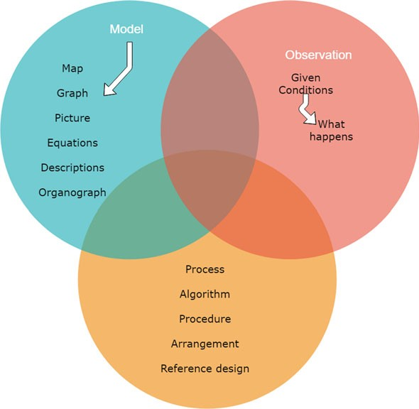
.
The ways of developing and accessing knowledge come in three:
Fig. 1.2 The categories of knowledge in research

Slide 15
.
Observation is the most fundamental way of obtaining information from a source.
(Observation takes different forms from something like measurements in a laboratory to a survey among a group of subjects to the time it takes for a firmware routine to run. The observational data often needs to be processed in some form and this leads to the second category of knowledge, the model.)
Models are approximated, often simplified ways of describing sometimes very complex interactions in the form of a statistical relationship, a figure, or a set of mathematical equations. (Map ,graphs, pictures ,equations, etc)
The final category is a way of arranging or doing things through processes, algorithms, procedures, arrangements, or reference designs, to get a certain desired result.

Slide 16
.
OBJECTIVES OF ENGINEERING RESEARCH
The objective of engineering research is to solve new and important problems, and since the conclusion at the end of one’s research outcome has to be new.
The main aim of the research is to apply scientific approaches to seek answers to open questions, and although each research study is particularly suited for a certain approach.
The following are different types of research studies: exploratory or formulative, descriptive, diagnostic, and hypothesis-testing.
The objectives of engineering research is to develop new theoretical or applied knowledge and not necessarily limited to obtaining abilities to obtain the desired result.

Slide 17
.
MOTIVATION IN ENGINEERING RESEARCH
The intention of doing research may be one or more of the following:
(i) Studies have shown that intrinsic motivations like interest, challenge, learning, meaning, purpose, are linked to strong creative performance;
(ii) Extrinsic motivating factors like rewards for good work include money, fame, awards, praise, and status are very strong motivators, but may block creativity. For example: Research outcome may enable obtaining a patent which is a good way to become rich and famous.
(iii) Influences from others like competition, collaboration, commitment, and encouragement are also motivating factors in research.

Slide 18
.
For example:
My friends are all doing research and so should I, or, a person that I dislike is doing well and I want to do better.
(iv) Personal motivation in solving unsolved problems, intellectual joy, service to community, and respectability are all driving factors.
(v) Several other factors like government directives, funding opportunities in certain areas, and terms of employment, can motivate people to get involved in engineering research.

Slide 19
.
TYPES OF ENGINEERING RESEARCH
The different types of research are:
1. Descriptive Vs Analytical Research:
Descriptive research consists of surveys and fact-finding enquiries of different types.
The main objective of descriptive research is describing the state of affairs as it prevails at the time of study.
The term ‘ex post facto research‘ is quite often used for descriptive research studies .
The most distinguishing feature of this method is that the researcher has no control over the variables here. He/she has to only report what is happening or what has happened.
Majority of the ex post facto research projects are used for descriptive studies in which the researcher attempts to examine phenomena, such as the consumers‘ preferences, frequency of purchases, shopping, etc. and also comprise attempts by them to discover the causes of the selected problem.
Analytical research, the researcher has to use the already available facts or information, and analyze them to make a critical evaluation of the subject.

Slide 20
.
2. Applied Vs Fundamental Research:
Research can either be applied research or fundamental (basic or pure) research.
Applied research seeks to solve an immediate problem facing the organization, whereas fundamental research is concerned with generalizations and formulation of a theory.
Research concerning natural phenomena or relating to pure mathematics are examples of fundamental research.
Research to identify social or economic trends, or those that find out whether certain communications will be read and understood are examples of applied research.
The primary objective of applied research is to determine a solution for compelling problems in actual practice.

Slide 21
.
3. Quantitative Vs Qualitative Research:
Quantitative research relates to aspects that can be quantified or can be expressed in terms of quantity.
It involves the measurement of quantity or amount.
Econometric methods adopted for includes correlation, regressions and time series analysis etc .
Qualitative research is concerned with qualitative phenomena, or more specifically, the aspects related to or involving quality or kind.
For example, an important type of qualitative research is Motivation Research‘, which investigates into the reasons for certain human behavior. The main aim of this type of research is discovering the underlying motives and desires of in-depth interviews.
Qualitative research is particularly significant in the context of behavioral sciences, which aim at discovering the underlying motives of human behavior.

Slide 22
.
  Finding and Solving a Worthwhile Problem
A researcher may start out with the research problems stated by the Supervisor or posed by others that are yet to be solved.
It may involve rethinking of a basic theory, or need to be formulated or put together from the information provided in a group of papers suggested by the Supervisor.
Research scholars are faced with the task of finding an appropriate problem on which to begin their research.
Skills needed to accomplish such a task at the outset, while taking care of possible implications .
A worthwhile research problem would have one or more attributes.
- It could be non intuitive/counterintuitive even to someone who knows the area.
-Something that the research community had been expecting for sometime.

Slide 23
,
-A new result which would start off a new subject or an area, provides a new method or improves upon known methods of doing something which has practical applications.
The researcher has to be convinced that the problem is worthwhile before beginning to tackle it because best efforts come when the work is worth doing.
The problem and/or solution has a better chance of being accepted by the research community. Not all problems that one solves will be great, and sometimes major advancements are made through solutions to small problems dealt with effectively.

Slide 24
.
The recommended steps to solve a research problem are:
1. Understand the problem, restate it as if its your own, visualize the problem by drawing figures, and determine if something more is needed.
2. One must start somewhere and systematically explore possible strategies to solve the problem or a simpler version of it while looking for patterns.
3. Execute the plan to see if it works, and if it does not then start over with another approach. Having delved into the problem and returned to it multiple times, one might have a flash of insight or a new idea to solve the problem.
4. Looking back and reflecting helps in understanding and assimilating the strategy, and is a sort of investment into the future.

Slide 25
.
PART-2
Ethics in Engineering Research
Ethics generally refers to a set of rules distinguishing acceptable and unacceptable conduct, distinguishing right from wrong.
Although everyone recognizes some common ethical norms, but there is difference in interpretation and application.
Ethical principles can be used for evaluation, proposition or interpretation of laws .
Government bodies, and universities worldwide have adopted certain codes for research ethics.
Research ethics examines the appropriate application of research outcomes, while responsible conduct of research deals with the way the work is undertaken.

Slide 26
.
  Ethics in Engineering Research Practice
Ethics in engineering research practice is essential to ensure the responsible and accountable development of new technologies, products, and solutions that benefit society while minimizing harm.
It encloses various aspects, including the treatment of research subjects, transparency, honesty, and the broader societal impact of research outcomes.
Engineering ethics involves identifying and addressing ethical issues that arise in engineering practice, such as safety, sustainability, and social responsibility.
Researchers make many choices that matter from an ethical perspective and influence the effects of technology in many different ways:
1. By setting the ethically right requirements at the very outset, engineering researchers can ultimately influence the effects of the developed technology.

Slide 27
.
2. Influence may also be applied by researchers through design (a process that translates the requirements into a blueprint to fulfill those requirements). During the design process, decision is to be made about the priority in importance of the requirements taking ethical aspects into consideration.
3. Thirdly, engineering researchers have to choose between different alternatives fulfilling similar functions.
It is a vital ethical responsibility of researchers to ensure that hazards/risks associated with the technologies that they developed, are minimized and alternative safer mechanisms are considered.
If possible, the designs should be made inherently safe such that they avoid dangers, or come with safety factors, and multiple independent safety barriers, or if possible a supervisory mechanism to take control if the primary process fails.

Slide 28
.
TYPES OF RESEARCH MISCONDUCT
Engineering research should be conducted to improve the state-of-the-art of technologies.
Research integrity should be dealt fairly with others, honesty about the methods and results, replicating the results wherever possible so as to avoid errors, protecting the welfare of research subjects, ensuring laboratory safety, and so forth.
In order to prevent mistakes, peer reviews should take place before the research output is published.
There may be different types of research misconduct which can be summarized as follows:
1. Fabrication (Illegitimate creation of data): Fabrication is the act of conjuring data or experiments with a belief of knowledge about what the conclusion of the analysis or experiments would be, but cannot wait for the results possibly due to timeline pressures from supervisor or customers.

Slide 29
.
2. Falsification (Inappropriate alteration of data):
Falsification is the misrepresentation or misinterpretation, or illegitimate alteration of data or experiments.
Falsification and fabrication of data and results, hamper engineering research, cause false empirical data to percolate in the literature, wreck trustworthiness of individuals involved, and cause actual and avoidable delays in technical advancement.
Misleading data can also crop up due to poor design of experiments or incorrect measurement practices.
3. Plagiarism (Taking other’s work sans attribution):
Plagiarism takes place when someone uses or reuses the work (including portions) of others (text, data, tables, figures, illustrations or concepts) as if it were his/her own without explicit acknowledgement.

Slide 30
.
Copying or reusing one’s own published work is termed as self-plagiarism and is also an unacceptable practice in scientific literature.
The increasing availability of scientific content on the internet seems to encourage plagiarism in certain cases, but also enables detection of such practices through automated software packages.
Although there are many free tools and also paid tools available that one can procure institutional license of, one cannot conclusively identify plagiarism.

Slide 31
.
4.Other Aspects of Research Misconduct :
Serious deviations from accepted conduct could be construed as research misconduct.
When there is both deception and damage, a fraud is deemed to have taken place. Sooner or later ethical violations get exposed.
Simultaneous submission of the same article to two different journals also violates publication policies.
Another issue is that when mistakes are found in an article or any published content, they are generally not reported for public access unless a researcher is driven enough to build on that mistake and provide a correct version of the same.

Slide 32
.
ETHICAL ISSUES RELATED TO AUTHORSHIP
Academic authorship involves communicating scholarly work, establishing priority for their discoveries, and building peer-reputation.
There important research conduct and ethics related issues connected to authorship of research papers are summarized herewith in the context of engineering research. Credit for research contributions is attributed in three major ways in research publications by:
--Authorship (of the intended publication),
--Citation (of previously published or formally presented work), and
--Through a written acknowledgment (of some inputs to the present research).

